Slide 1

Pre-Project Presentation
Door Unlocking System based on
Facial Recognition using Machine Learning
Abhilash (160117734072)
Poojith (160117734096)
Amaan (160117734090)
B. E. 4/4 EEE D2
Internal Guide :
Dr.K.Krishna Veni Professor
‹#›

Slide 2

Aim of the Project
Help users improve Door Security using Facial Detection and Recognition and securing it further by using Cyber Security techniques.
To design a facial recognition system which accurately recognize live faces and provide secured access.
Uses :
(Biometric log registry) - Can be used as a Biometric system to capture people’s Entry and Exit time.
(Secured Environment Access) - Can be used for theft detection. (our project)
‹#›

Slide 3

Project Objectives
To develop Facial recognition system using software and design methodology and to set hardware components/simulation model for door unlocking system.
To implement machine learning and deep learning techniques by computer vision with OpenCV and Python to build advanced computer vision applications.
To ensure a real time application of the project.
Software and algorithm of OpenCV software library along with various Python Modules help is used in the Application development of face recognition.
To test and implementation, The system is able to detect face accurately and recognize the face and inform the owner or not after examined carefully.
Applying concepts acquired in the project to other Machine Learning Problem Statements.
‹#›

Slide 4
Roles of Members:
Abhilash : Coding and Software Developer (Face Training and Recognition, Application)
Poojith :Coding and Software Developer
(OpenCV, Face Storing)
Amaan : Security Developer
( OTP generation, SMS request , Whatsapp request)
‹#›

Slide 5

Project Description
WHAT IS AN APPLICATION?
An application, often shortened to app, is a program or set of programs that allows end users to perform particular functions.
Front End – Front-end development is the work on the visual, client-facing aspects of an application or website
Middle End – In computing, source code is any collection of code, with or without comments, written using a human readable programming language.
Back End –The back end refers to parts of a computer application or a program's code that allow it to operate and that cannot be accessed by a user.
Front-End Middle End Back-End
(GUI) Code progra- (Data Storing)
-mming
‹#›

Slide 6
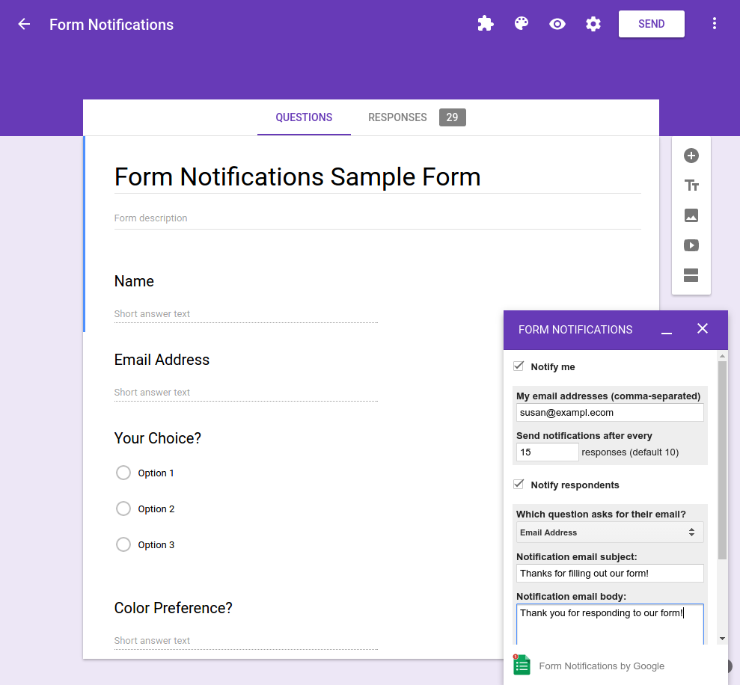
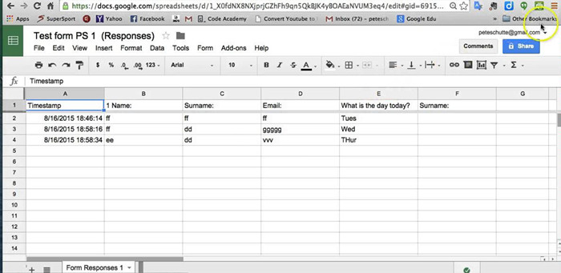
Back End
Front End
‹#›

Slide 7
Workflow
Face & Eye Detection
Front End (GUI)
Face Storing
Security Additions (OTP)
Face Training
Back End (Data Storing)
Face Recognition
Door Unlocking

Slide 8
Intro To Python & Machine Learning
Python is a general-purpose programming language that is becoming ever more popular for data science. Python also lets you work quickly and integrate systems more effectively.
The applications include: Web and Internet Development , Database Access, Desktop GUIs, Network Programming, Software & Game Development..etc.
Machine Learning (ML) is the study of computer algorithms that improve automatically through experience and by use of data. Applications include: medicine, email filtering, computer vision.
By using the Machine learning algorithm based on convolutional neural networks, cameras can now recognise faces covered with masks. Data science engineers utilise such algorithms as face-eye-based multi-granularity and periocular recognition models to enhance the facial recognition system's capabilities.
‹#›

Slide 9
Intro to Open CV
Open CV( Open Source Computer Vision Library) is an open source computer vision and machine learning Software Library. It has C++, C, Python and Java (Android) interfaces and Supports windows, linux, IOS, MacOS, with more than 2500 algorithms.
Computer vision can be defined as a discipline that explains how to reconstruct, interrupt, and understand a 3D scene from its 2D images, in terms of the properties of the structure present in the scene. It overlaps with Image processing, pattern recognition, photogrammetry.
Features of OpenCV library- * read and write images,*capture and save videos,*process images (filter, transform), perform feature detection, detect faces, eyes, cars, in the videos or images.
Applications includes: Robotics,, Biometrics, Autonomous Vehicle, Self driving cars,, Military Applications etc.In our project we import OpenCV library in Pycharm IDLE by using command “importCv2”

Slide 10
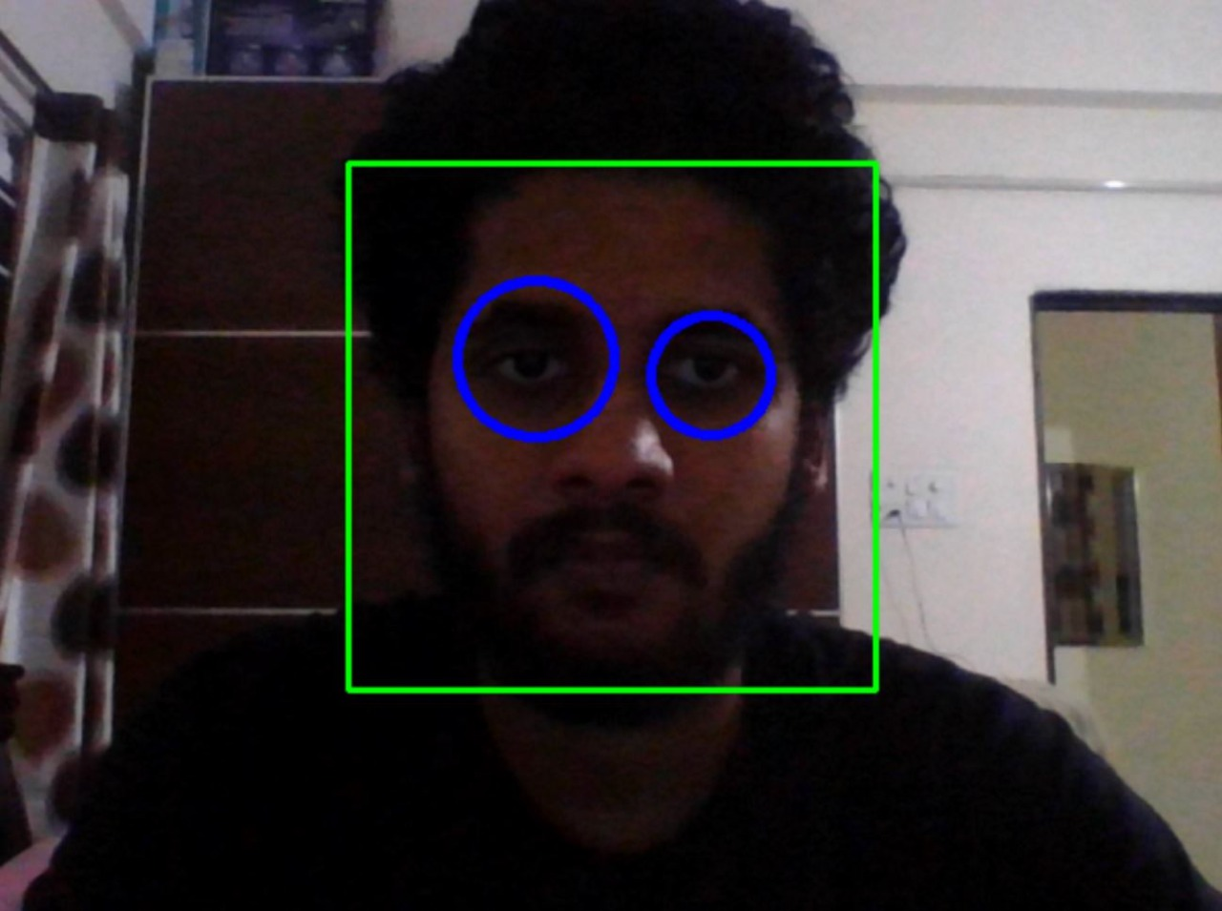
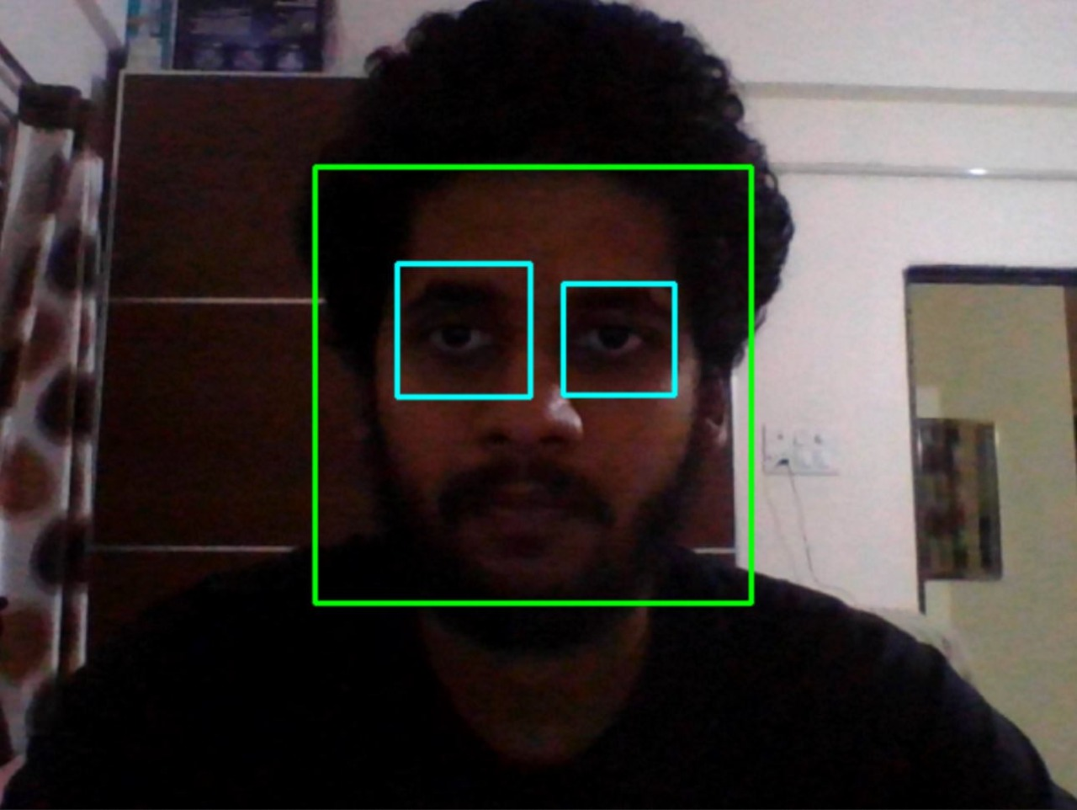
Face & Eye detection
Face Detection is a type of application classified under “computer vision” technology. It is the process in which algorithms are developed and trained to properly locate faces or objects, in images.
Face detection is different from face recognition, but they depend on each other. So, In our case face recognition needs face detection for making an identification to “recognise” a face.
We need to detect face and then move on to next steps its very important, to find a face in the screen.
According to our requirement we can go with Either the Shape of Rectangle or Circle

Slide 11
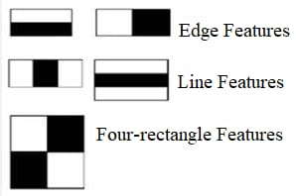
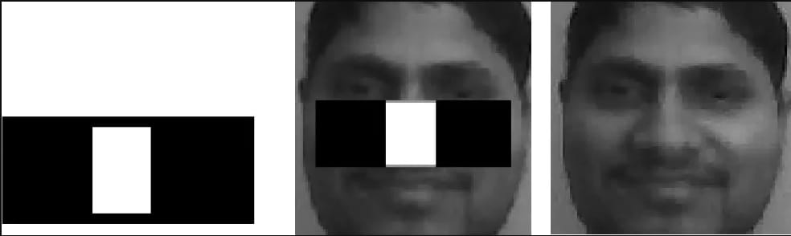
Algorithm Behind Detection
The Face Detection generally works on the principle of viola jones algorithm, this algorithm works on grayscale image, the algorithm looks at many smaller subregions and tries to find a face by looking for specific features in each subregion.
The viola jones algorithm has four main steps: 1. selecting Haar-like features, 2. Creating an Integral image, 3. Adaboost training, 4. creating classifier cascades.
Haar-like features
The value of the feature is calculated as a single number: the sum of pixel values in the black area minus the sum of pixel values in the white area.

Slide 12
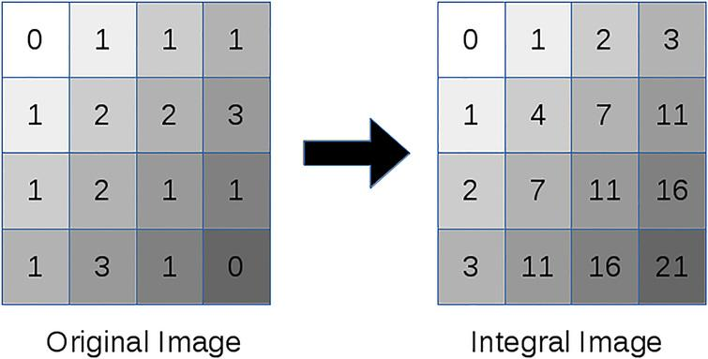
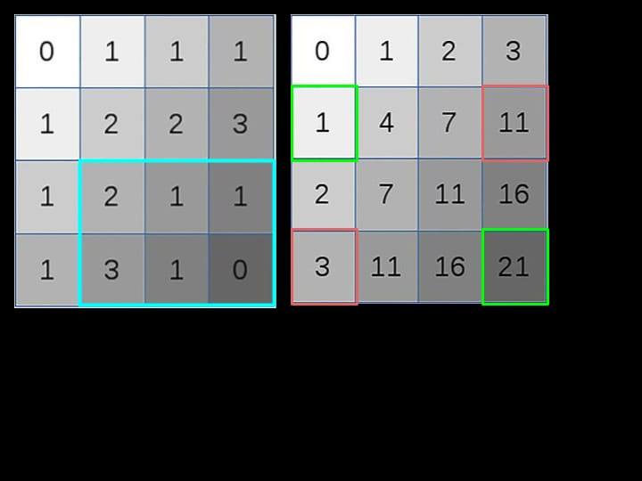
2. Creating an Integral Image
3. AdaBoost training
Adaboost checks the performance of a classifier that we supply to it,To calculate the performance of a classifier, you evaluate it on all subregions of all the images used for training.
4. Classifier Cascades
The job of the cascade is to quickly discard non-faces, and avoid wasting precious time and computations. Thus, achieving the speed necessary for real-time face detection.

Slide 13
Face Storing
After Face detection, and analysing the features of the face the face images are stored in the particular system folder data set and they are later used for further extracting features in facial recognition and training.
The facial capturing method requires a python script to facilitate building our custom face recognition data set. The python script will :
Access the webcam
Detect faces in the frame
Store the faces into the disk
The important exception is while storing, if more than two faces are detected by the camera, the code will stop running the camera and raises an error message while face storing.

Slide 14
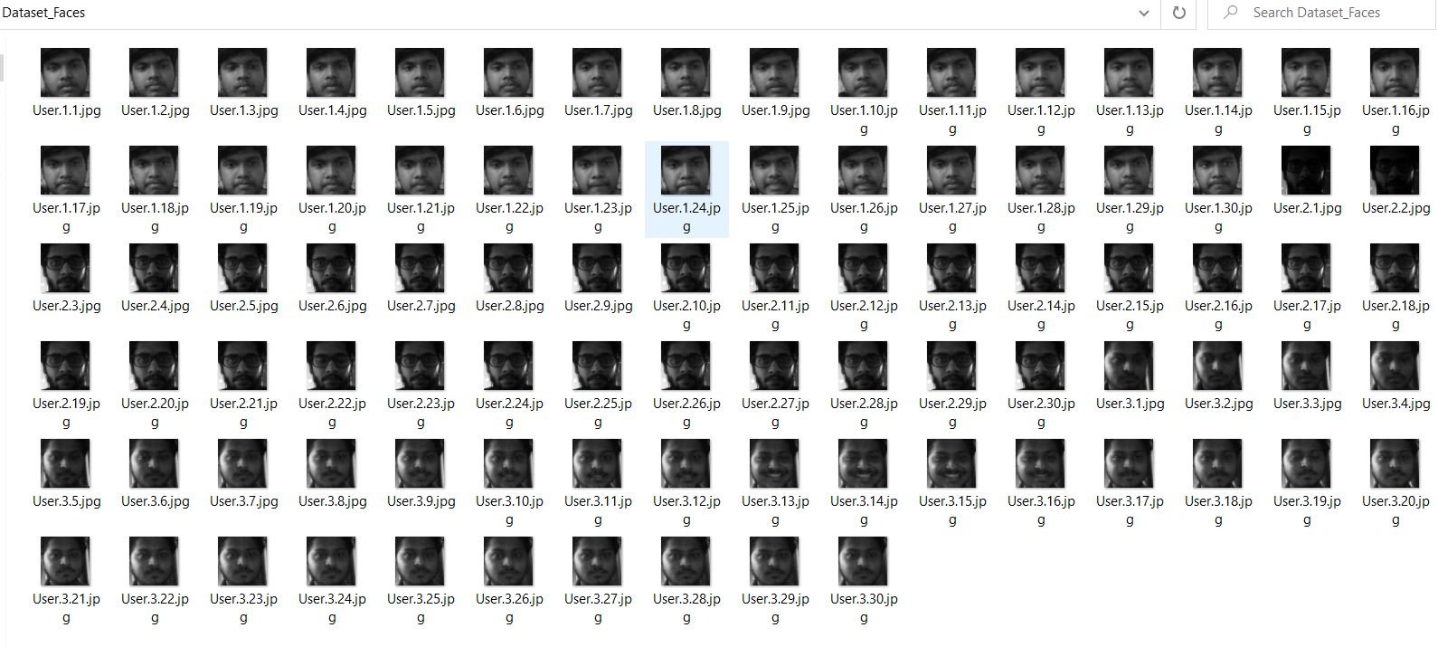
Stored Faces of Admin and User’s
Here the first user becomes the ADMIN by default, and next entries will be deemed as USERS

Slide 15
Security Additions
There are many loopholes which can be found for a facial recognition system.
The main loophole will be the identification of high privileged user and the low privileged user.
The information that is gathered by the system about the low privileged user and how is the access granted to the low privileged user to store his/her face.
To solve these issues we have set a system of otp generation on each time when a new user wants to store his /her faces.
The otp generation code is written by python as well for sending sms an api which has its own library in python named twillio is used.

Slide 16
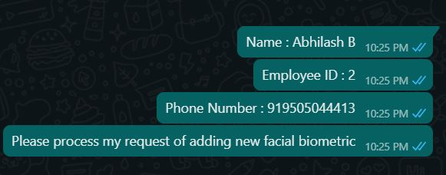
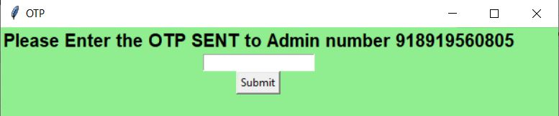

Twilio is an American cloud communications platform
Twilio uses Amazon Web Services to host telephony infrastructure and provide connectivity between HTTP and the public switched telephone network (PSTN) through its APIs.
OTP is generated randomly between numbers 0000-9999.
Also the user details are sent to the admin and once the admin clears the details of the user and reveals the OTP the user can then only try to store their faces.
‹#›

Slide 17
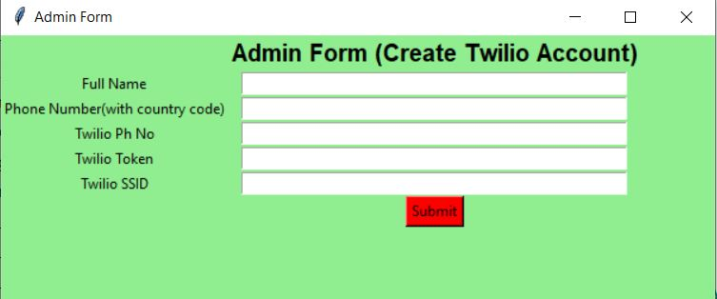
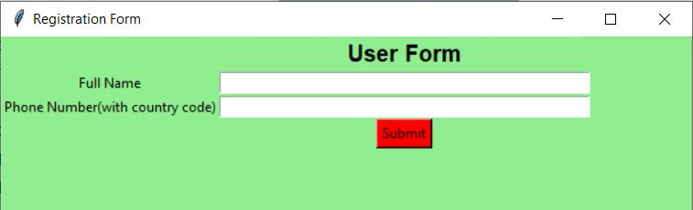
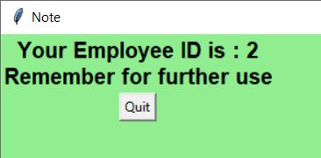
Front End
Python -tkinter:
Tkinter is the standard GUI library for Python. Python when combined with Tkinter provides a fast and easy way to create GUI applications. Tkinter provides a powerful object-oriented interface to the Tk GUI toolkit.
Out of all the GUI methods, tkinter is the most commonly used method. It is a standard Python interface to the Tk GUI toolkit shipped with Python.
Python with tkinter is the fastest and easiest way to create the GUI applications.

Slide 18
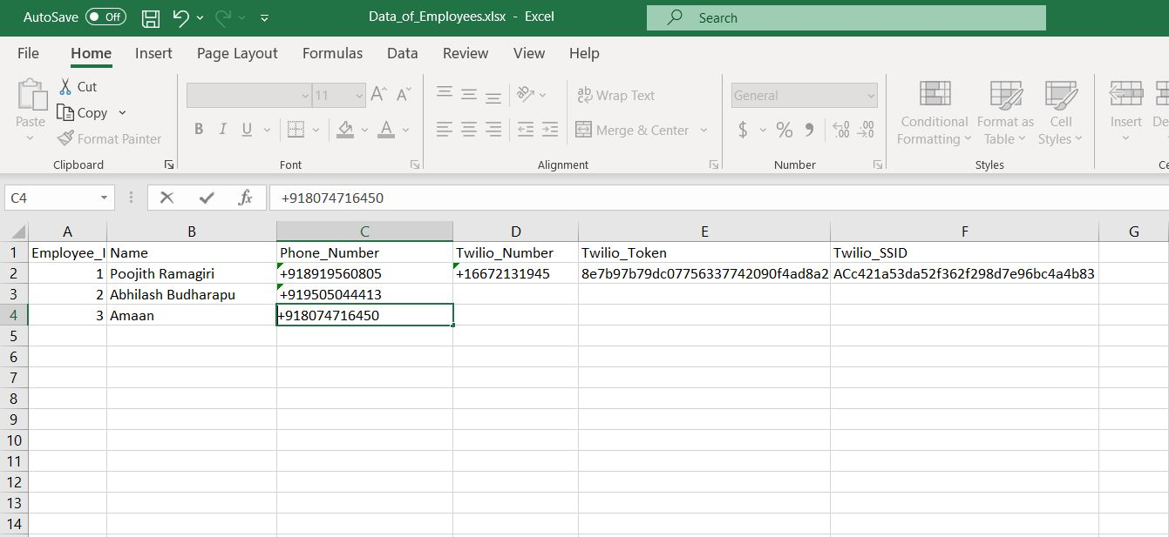
Back End
Python- pandas
A back-end application or program supports front-end user services, and interfaces with any required resources. The back-end application may interact directly with the front end. The back end system consists of frameworks and database management system.
In our application we use python- pandas module and storing the data in excel file.
Pandas is an open-source Python Library providing high-performance data manipulation and analysis tool using its powerful data structures.

Slide 19
Face Training
In order to move on to the next step i.e, Face Recognition, Face Training plays an Important Role.
It is necessary for the Machine Learning Algorithm to Store Important Facial Features of individuals for further recognition.
The Model does this by creating a yml or xml extension files. These files contains all the Data Features of the entire users.
It stores the features of persons individually in the form of Matrices.
This file is then used for Face Recognition.

Slide 20
Face Recognition
A facial recognition system is a technology capable of matching a human face from a digital image or a video frame against a database of faces, typically employed to authenticate users through ID verification services
While humans can recognize faces without much effort, facial recognition is a challenging pattern recognition problem in computing.
The recognized faces are matched with the Dataset of Faces with their Unique Identification in this case Employee_ID, after a match is found it is displayed on the screen with their Names around the box. Faces are detected based on the confidence/accuracy from (0-100)%. The accuracy increases with an (“Optimal DataSet”)
If no person is found with the DataSet it will deem it as “Unknown” and the door doesn’t open.

Slide 21
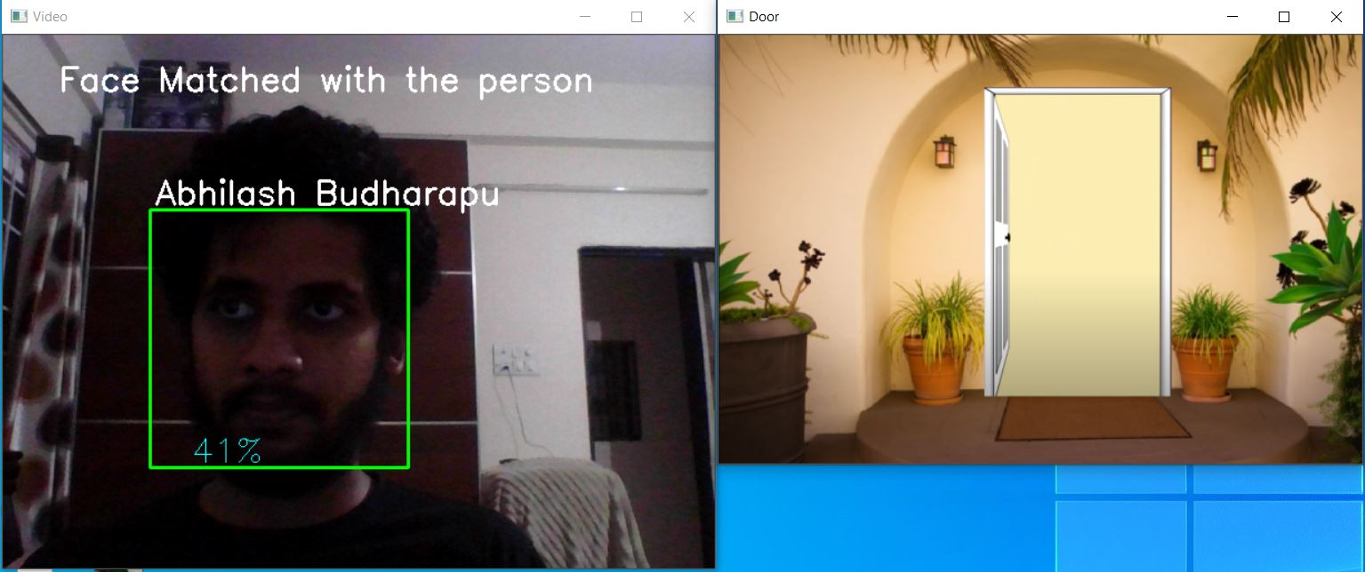
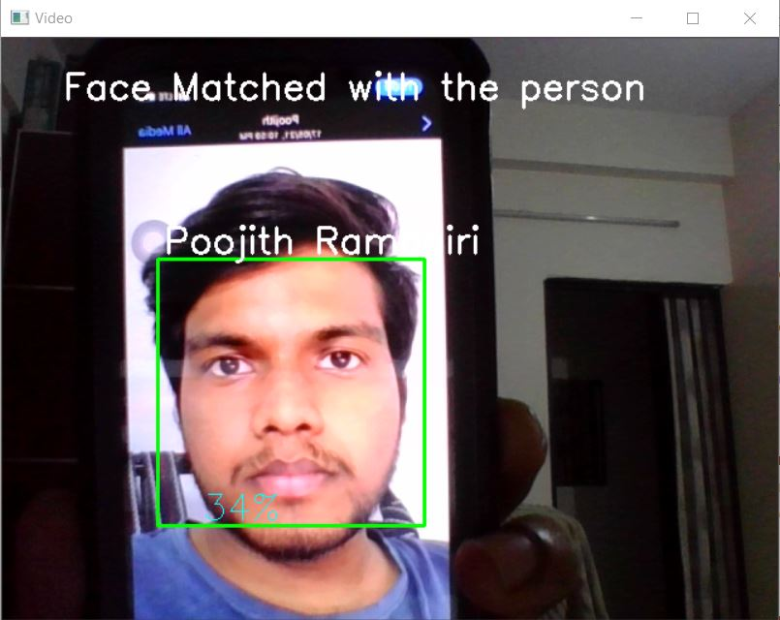
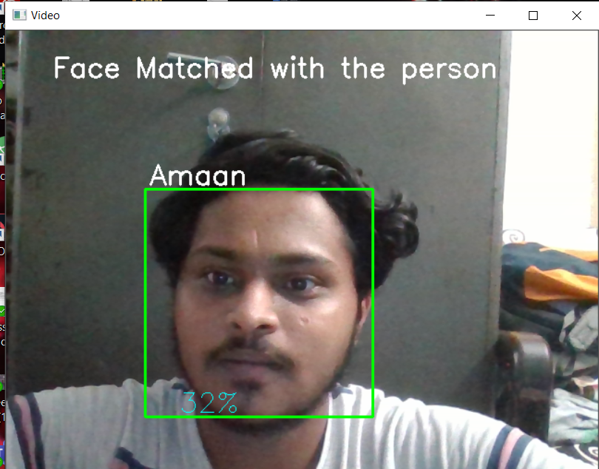

Slide 22
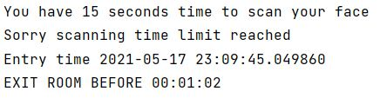
Application – Secured Room
Timed Face Recognition : To make the system more secure, we’ve added a timer circuit to the application this make the entire face scanning time to last for a fixed amount of time (which can be modified).
Working of Application - Secured Room :
There would be Timed Facial Recognition done while “ENTRY” as well as the “EXIT” which would last for fixed time.
The Person Entering needs to Exit through the same door which makes it a Secured Environment and need to scan within the mentioned time.
After Entering the door a “TIMER” would starting running indicating the time before which he has to exit through the door, if he fails to do so then the Door gets Locked and person gets trapped inside until be is identified by officials.
Uses :
ATM
Bank Locker System
Security Rooms
Restricted Access Rooms etc.

Slide 23
Further Development
In Addition, our project is limited upto virtual simulation of door access control but it can further implemented by using hardware components.
The hardware implementation can be done using two ways:
By using raspberry pi and solenoid lock
By using Arduino and servo motor
The raspberry pi is a micro controller and solenoid lock is a strong electromagnetic lock which is operated through raspberry pi by using external memory.
Open CV and Python need to be installed along with our software in the module along with a pi camera is attached to the setup to achieve facial recognition.
Arduino is microcontroller device with varying amounts of flash memory, pins and features. It is connected to PC, the software In this case runs in the laptop and uses webcam of the laptop to capture face.
when face is recognised, Arduino send signals to servo motor, which rotates 90 degrees to open the door and turns anti clockwise to close the door. This method is least secured way because the lock is not electromagnetic.
To Increase the security we can use iris scan instead of face recognition..

Slide 24

References
1. Dalal N. and Triggs B. 2005. Histograms of Oriented Gradients for Human Detection. In Proceedings of IEEE International Conference onComputer Vision and Pattern Recognition.
R. Chellappa, C.L. Wilson, and S. Sirohey, “Human and machine recognition of faces: Asurvey,” Proc. IEEE, vol. 83, pp. 705–740, 1995.
S. Prabhakar, S. Pankanti, and A. K. Jain, “Biometric recognition: Security and privacy concerns,” IEEE Security Privacy, vol. 1, no. 2, pp. 33–42, Mar./Apr. 2003.
Omkar Pawar, Prathamesh Lomkar, Randhir Singh, VivekSalunke and Prof. D.M. Ujlambkar,. “Door Lock System using Facial Recognition “, IJRASET March 2019.
‹#›

Slide 25

Benefits of the work
Will it result into a publication?
Can be used as Biometric System and Alarm Detection.
Will it result into a product?
Yes, a physical model can be developed using this method
Will it be a solution to an existing problem of an industry?
Yes, Biometric System loopholes can be eliminated also Security can be enhanced using this method and live theft detection and thief capturing can be achieved.
Is it pursued for academic interest?
Yes, really used for further studies in the field of Machine Learning and Computer Vision.
‹#›

Slide 26
Thank You
‹#›

